Slide 1


Open-Source Microsimulation for Agile Welfare Policy Analysis: Introducing PolicyEngine
Ben Ogorek
60th NAWRS Workshop
2025-08-04

Slide 2



A Data Scientist Discusses Data-Driven Policy Simulation: PolicyEngine
I’m Ben Ogorek, a PhD Statistician who’s worked as an industry data scientist for almost 20 years. At Google in 2013, I met
Max Ghenis, the CEO of PolicyEngine, who cofounded PolicyEngine with
Nikhil Woodruff, the CTO of PolicyEngine
Who together built an excellent team of
Economists
Engineers
Researchers & Writers
See more at policyengine.org/us/about
Max Ghenis
Co-founder and CEO
Nikhil Woodruff
Co-founder and CTO
Ben Ogorek
Data Scientist

Slide 3
The PolicyEngine Mission
To democratize economic policy analysis by creating a single, comprehensive, and universally accessible platform for understanding the impact of taxes and benefits on people's lives.
Notes:
“A public good”

Slide 4
Agenda
Motivation: The need for understanding the effects of The One Big Beautiful Bill Act (OBBBA)
The PolicyEngine Platform
PolicyEngine’s approach to microsimulation
Demo: Calculating taxes and benefits for a household, with and without a SNAP reform
PolicyEngine’s approach to microdata
Demo: California-wide impact of applying the same SNAP reform
Where PolicyEngine is going next

Slide 5
Policy is Complicated. Exhibit: OBBBA
Extends TCJA
Increases standard deduction
Raises the CTC
Expands the child and dependent care credit
Exempts tip and overtime income
Adds work requirements for SNAP and Medicaid
Restricts immigrants from receiving CTC, SNAP, Medicaid, and ACA subsidies
Audits EITC
Introduces senior deduction
Reforms SALT cap, alternative minimum tax, itemized deductions
Downstream state tax impacts
…and more

Slide 6
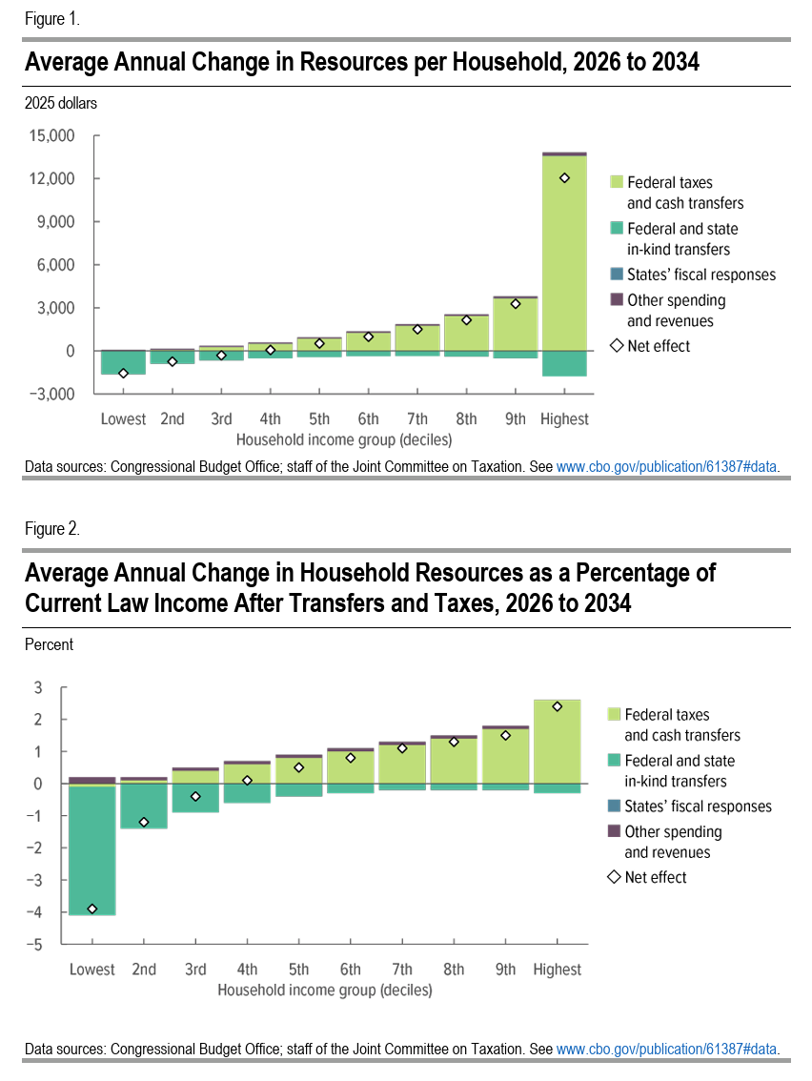
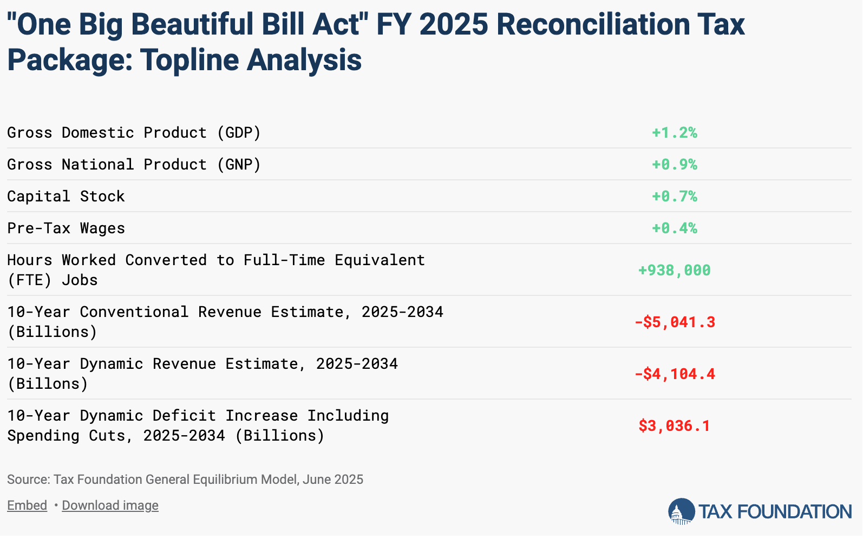
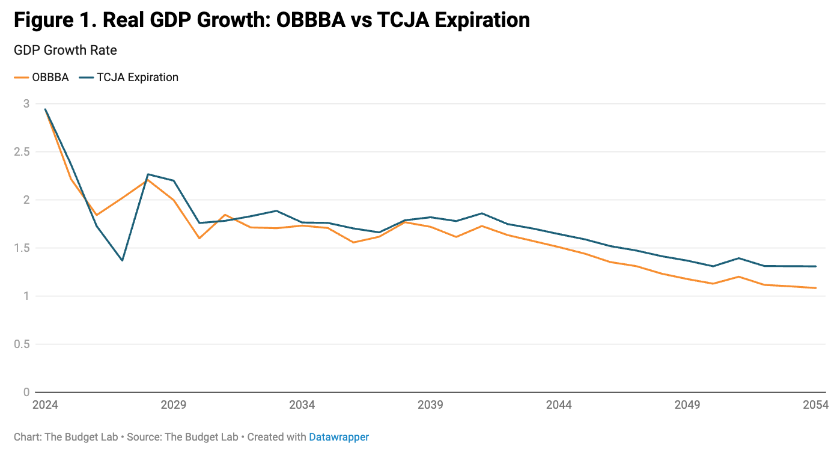
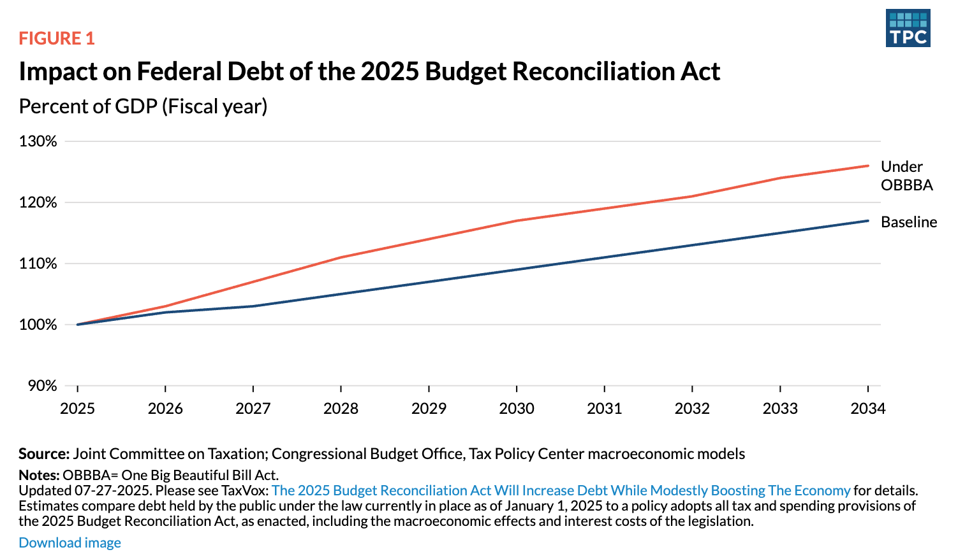
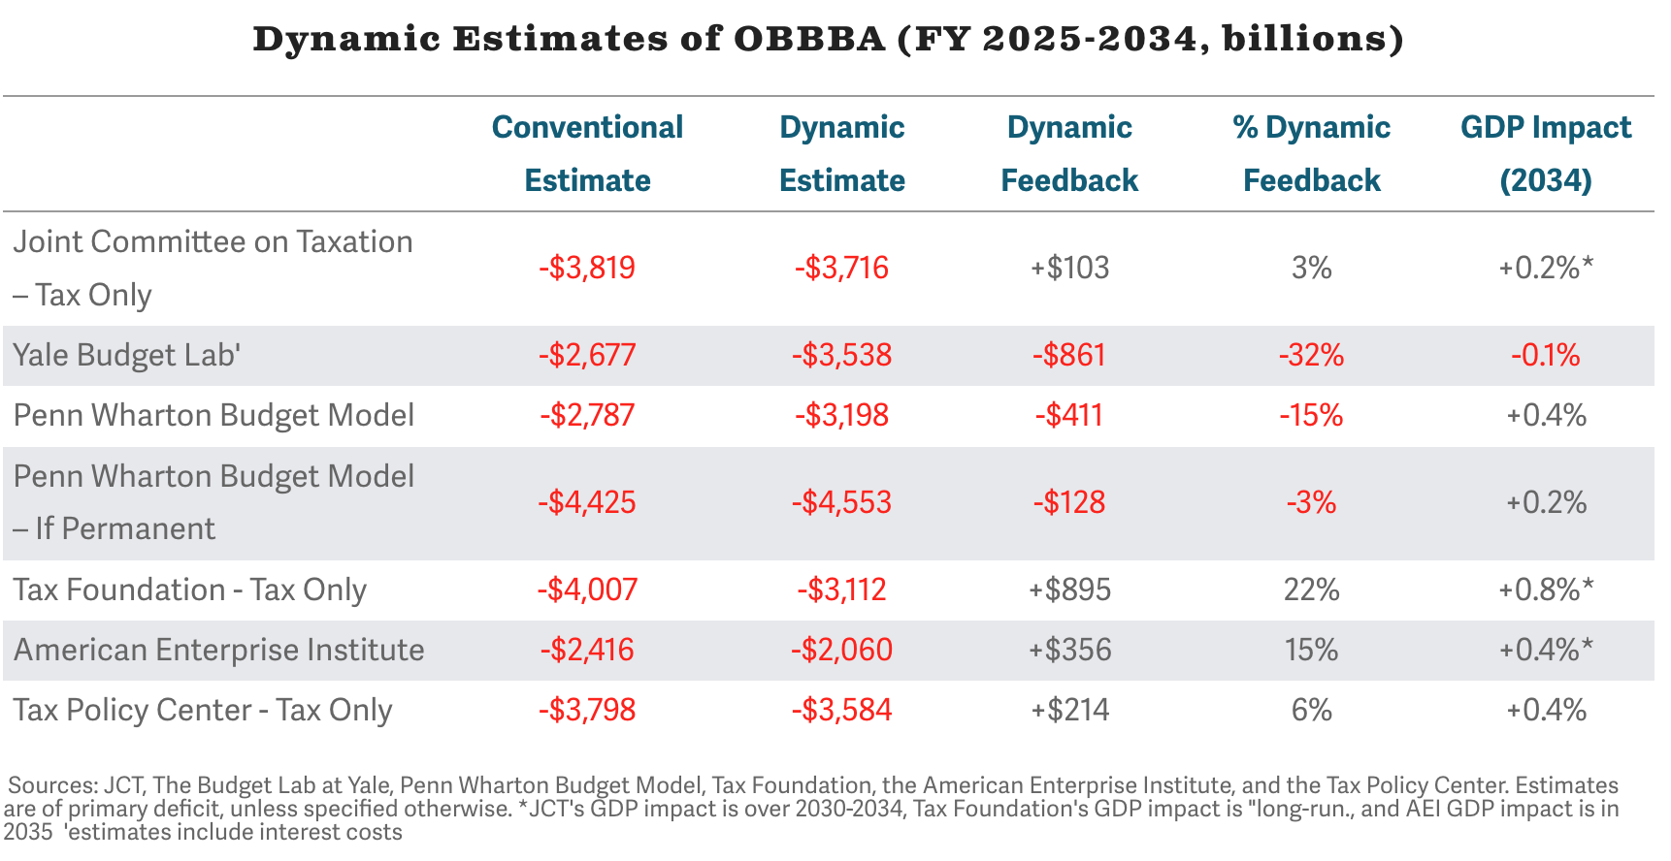
Analysts Estimate Aggregate Impacts
Source: CBO

Slide 7
Individuals Experience Impacts
But how will individual households experience the bill?
Source: CBO

Slide 8
Demo
policyengine.org/us/obbba-household-by-household
Notes:
Talk until the starfield. Pause. Up to 50k is the point of interest

Slide 9
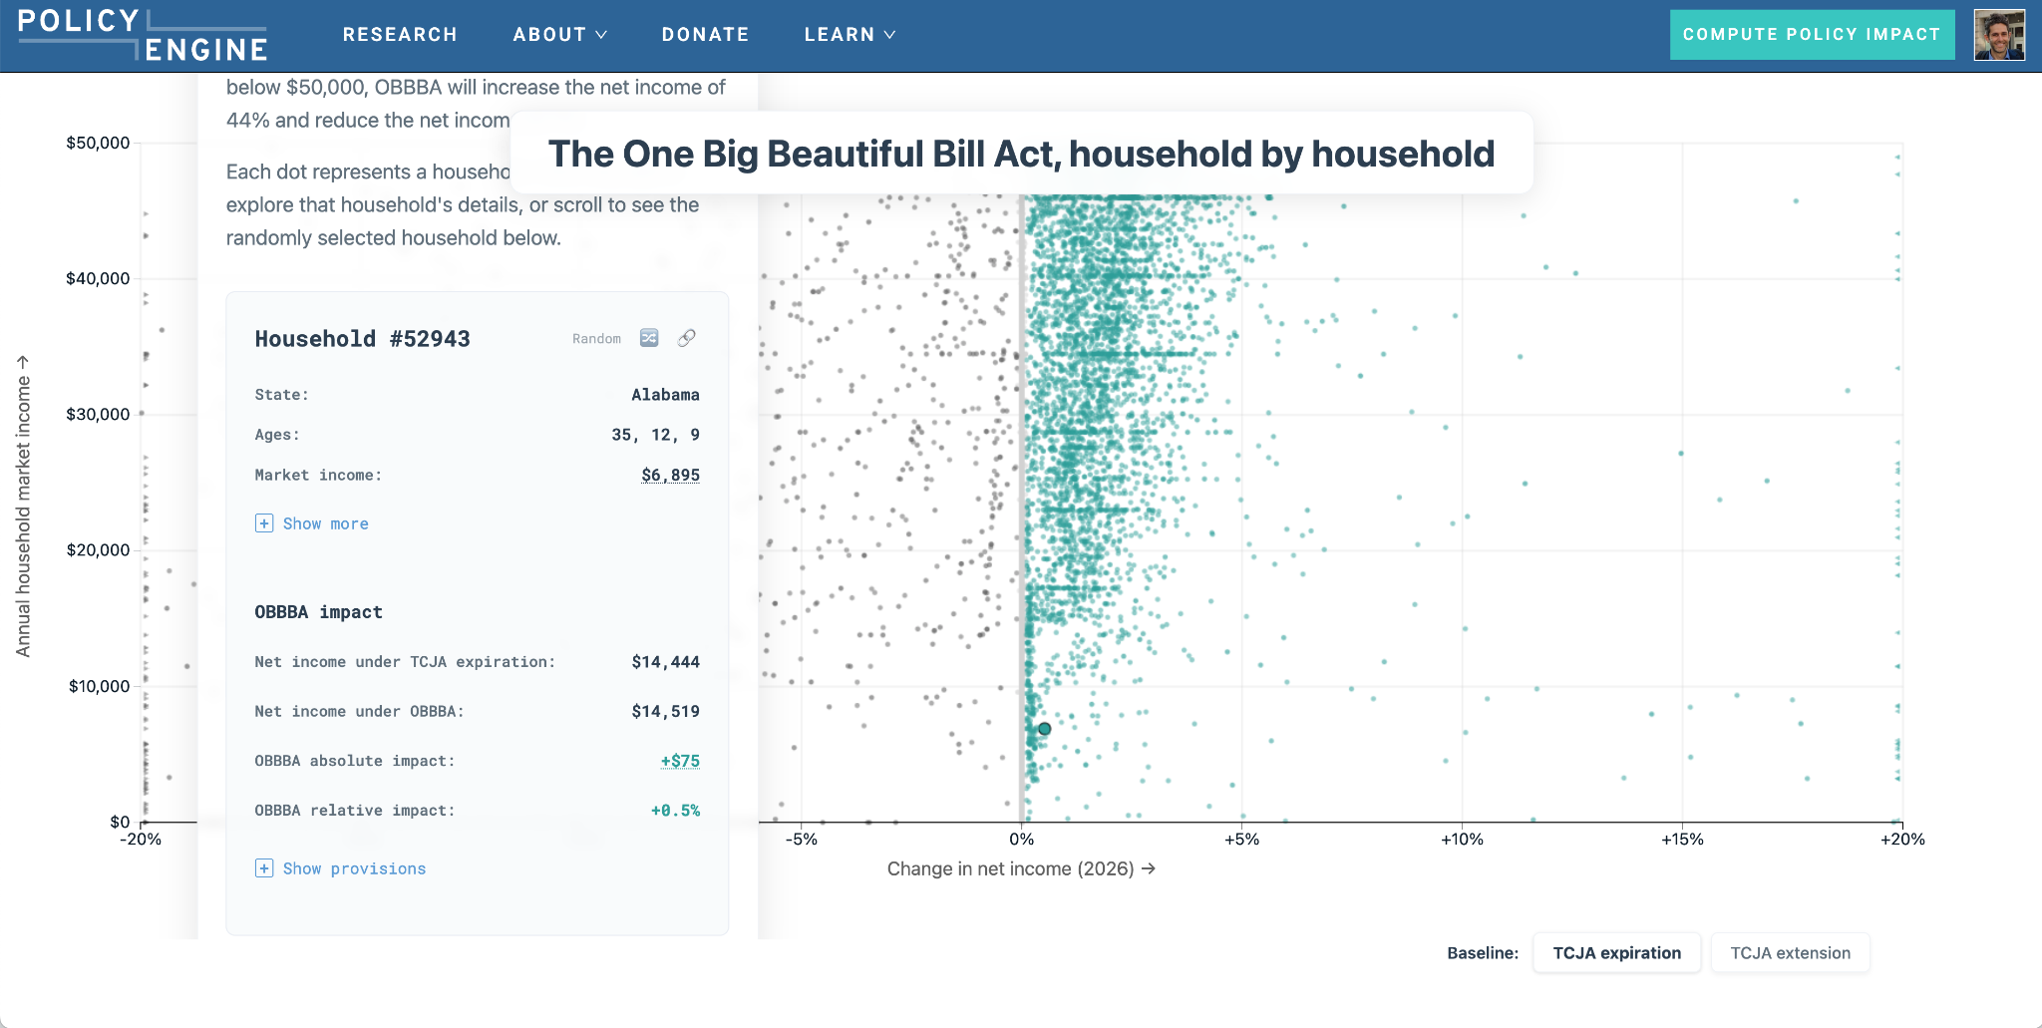
Policy Complexity Motivates a New Breed of Tools

Slide 10
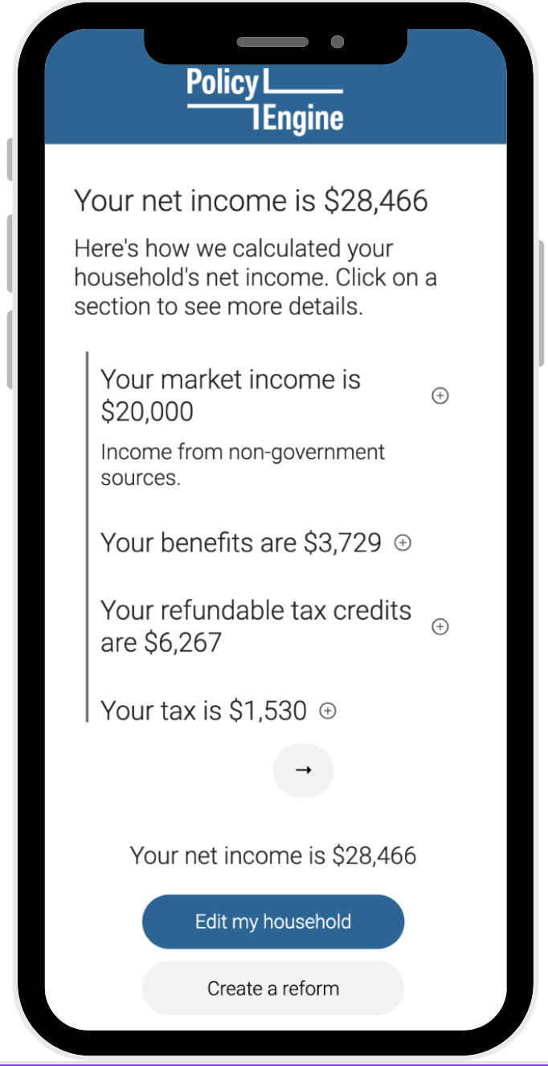
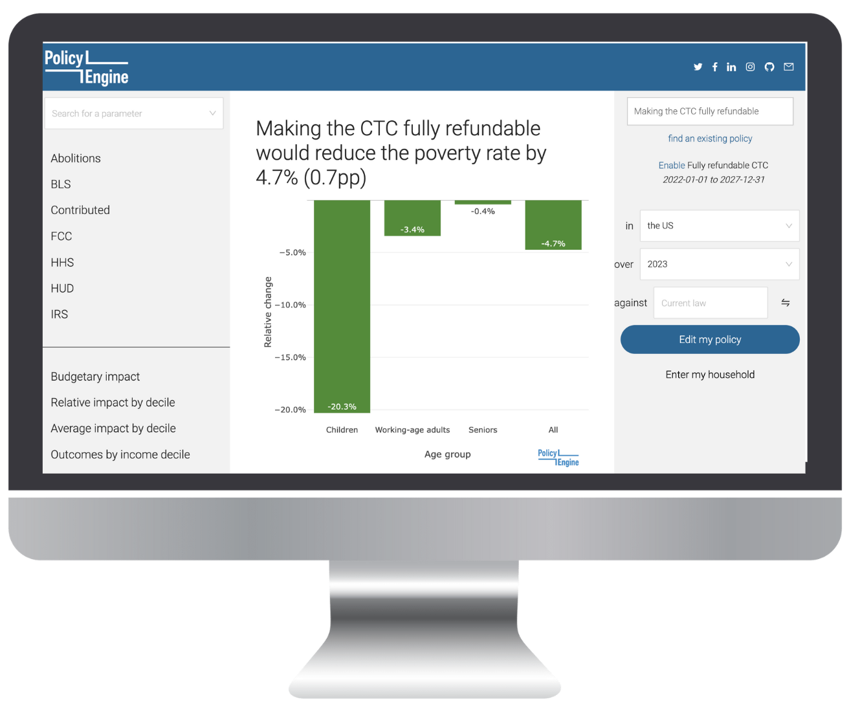
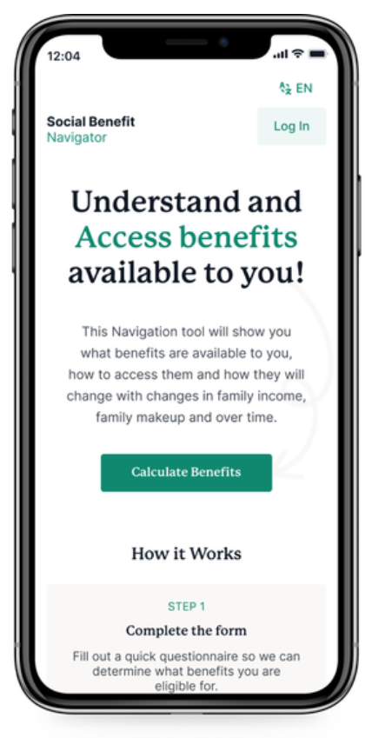
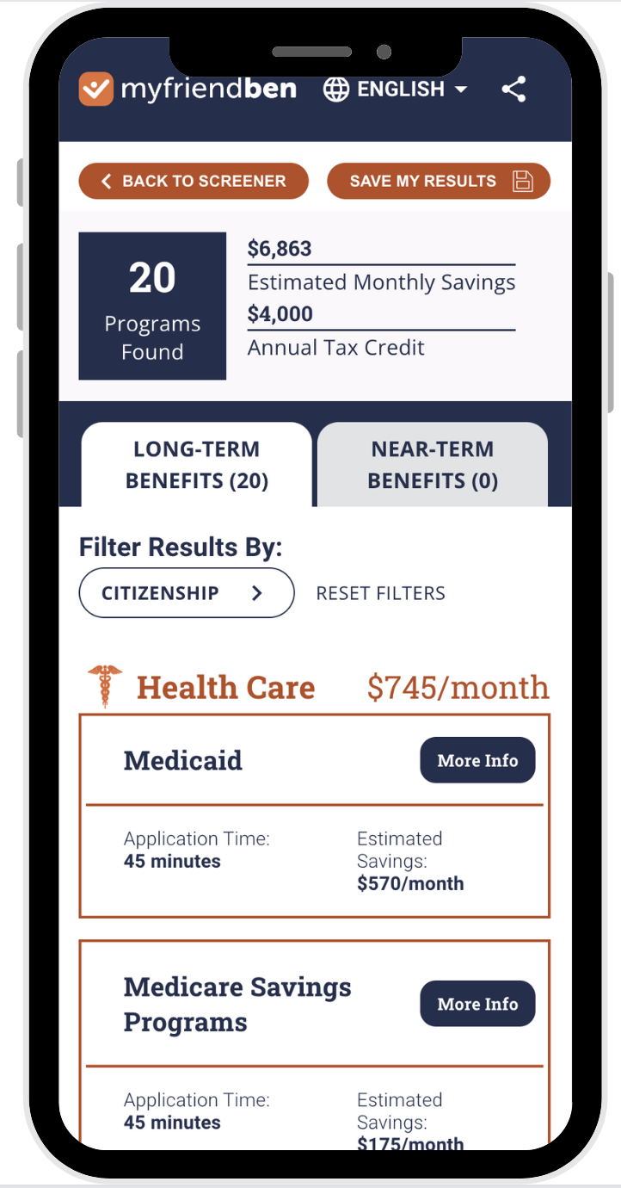
And our main platform powers it + more
Open source tax-benefit rules engine
Python package
PolicyEngine benefit calculations
Third party apps via API
PolicyEngine reform simulations

Slide 11
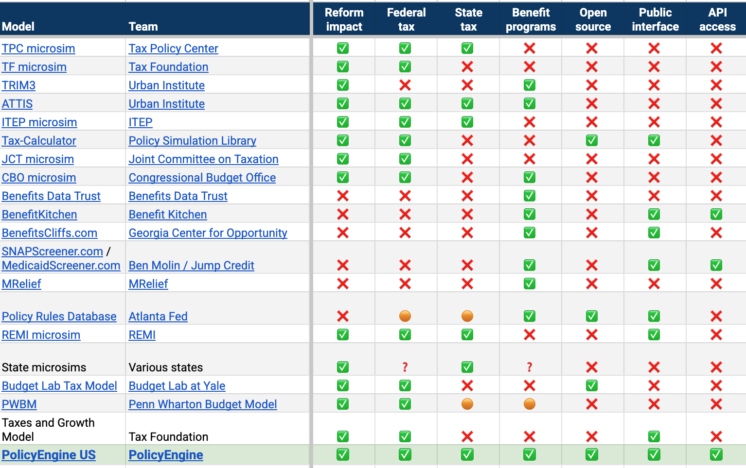
PolicyEngine: comprehensive & accessible
Notes:
For decades, policy analysis has been split into two worlds: powerful but inaccessible models used by experts, and easy-to-use but limited tools for the public. Our goal was to bridge that gap. On the comprehensiveness side, we're looking at whether a model can calculate the Reform impact, and if it includes Federal tax, State tax, and Benefit programs. You need all of these to see the full picture of how a policy affects a family's budget. On the accessibility side, we're asking: Is it Open source so anyone can see how it works? Is there a Public interface for anyone to use? And is there API access for developers and researchers to build with it? Then you have another category of fantastic tools like BenefitKitchen or MRelief. They're excellent at helping people access their benefits and have great public interfaces, but they aren't designed to model taxes or analyze the economy-wide impact of a new policy proposal.

Slide 12

Users Across Ideology & Domain Use PolicyEngine

Slide 13
Three Pillars of a Tax-Benefit Model
Rules
Dynamics
Data

Slide 14
Microsimulation Rests on All Three
Gross income | # kids
$100,000 | 0
Notes:
Mention it’s very rich and stylized example

Slide 15
Microsimulation
Rules
Baseline
Gross income | # kids | Taxes
$100,000 | 0 | $21,000

Slide 16
Microsimulation
Rules
Baseline
Reform
Gross income | # kids | Taxes | Taxes Static
$100,000 | 0 | $21,000 | $20,000

Slide 17
Microsimulation
Rules
Dynamics
Baseline
Reform
Gross income | # kids | Taxes | Taxes Static | Δ earnings
$100,000 | 0 | $21,000 | $20,000 | +$700

Slide 18
Microsimulation
Rules
Dynamics
Baseline
Reform
Gross income | # kids | Taxes | Taxes Static | Δ earnings | Tax w/ behavior
$100,000 | 0 | $21,000 | $20,000 | +$700 | $20,150

Slide 19
Microsimulation
Rules
Dynamics
Baseline
Reform
Gross income | # kids | Taxes | Taxes Static | Δ earnings | Tax w/ behavior | Δ tax
$100,000 | 0 | $21,000 | $20,000 | +$700 | $20,150 | -$850
Notes:
Interplay between the Income elasticity of demand and substitution effects

Slide 20
Microsimulation
Rules
Dynamics
Data
Baseline
Reform
Gross income | # kids | Taxes | Taxes Static | Δ earnings | Tax w/ behavior | Δ tax
$100,000 | 0 | $21,000 | $20,000 | +$700 | $20,150 | -$850
$100,000 | 2 | $12,000 | $10,000 | +$1,000 | $10,300 | -$1,700
$25,000 | 1 | -$3,000 | -$3,000 | $0 | -$3,000 | $0

Slide 21
Microsimulation
Rules
Dynamics
Data
Baseline
Reform
Gross income | # kids | Taxes | Taxes Static | Δ earnings | Tax w/ behavior | Δ tax | Weight
$100,000 | 0 | $21,000 | $20,000 | +$700 | $20,150 | -$850 | 500k
$100,000 | 2 | $12,000 | $10,000 | +$1,000 | $10,300 | -$1,700 | 700k
$25,000 | 1 | -$3,000 | -$3,000 | $0 | -$3,000 | $0 | 100k

Slide 22
Microsimulation
Rules
Dynamics
Data
Baseline
Reform
Gross income | # kids | Taxes | Taxes Static | Δ earnings | Tax w/ behavior | Δ tax | Weight
$100,000 | 0 | $21,000 | $20,000 | +$700 | $20,150 | -$850 | 500k
$100,000 | 2 | $12,000 | $10,000 | +$1,000 | $10,300 | -$1,700 | 700k
$25,000 | 1 | -$3,000 | -$3,000 | $0 | -$3,000 | $0 | 100k
… |  | … | … | … | … | … | …
TOTAL |  | $960B | $930B | +$10B | $935B | -$25B | 170M

Slide 23
PolicyEngine Innovates on Each Pillar
Rules
Dynamics
Data
Federal income & payroll tax
State income tax
SNAP, Medicaid, CHIP, ACA PTC, SSI, WIC, Free & reduced price school meals, TANF & CCDF (select states)
Labor supply elasticities
CPS ASEC foundation
Integrates IRS PUF, ACS, SCF, and SIPP
Calibrates to national aggregates
CBO-based ageing
Legislative references & thousands of unit tests
Adjustable parameters with US CBO presets
Machine learning (QRF + GD) boosts accuracy
Notes:
Note a drawback of just using one dataset General equilibrium

Slide 24
Demo
Calculate taxes and benefits for single parent of two in California, with $40,000 income and $1,000/mo rent
What if California lifts its SNAP net income limit?

Slide 25
More about microdata

Slide 26
Should Microsims Use Tax Data or Population Surveys?
IRS Public Use File
Current Population Survey
More accurate income
No sampling concerns
Well suited to tax analysis
More detailed income and deduction sources
Benefit programs
Poverty impacts
Hierarchical household structures with demographics
Openly available
More recent data
Includes nonfilers

Slide 27
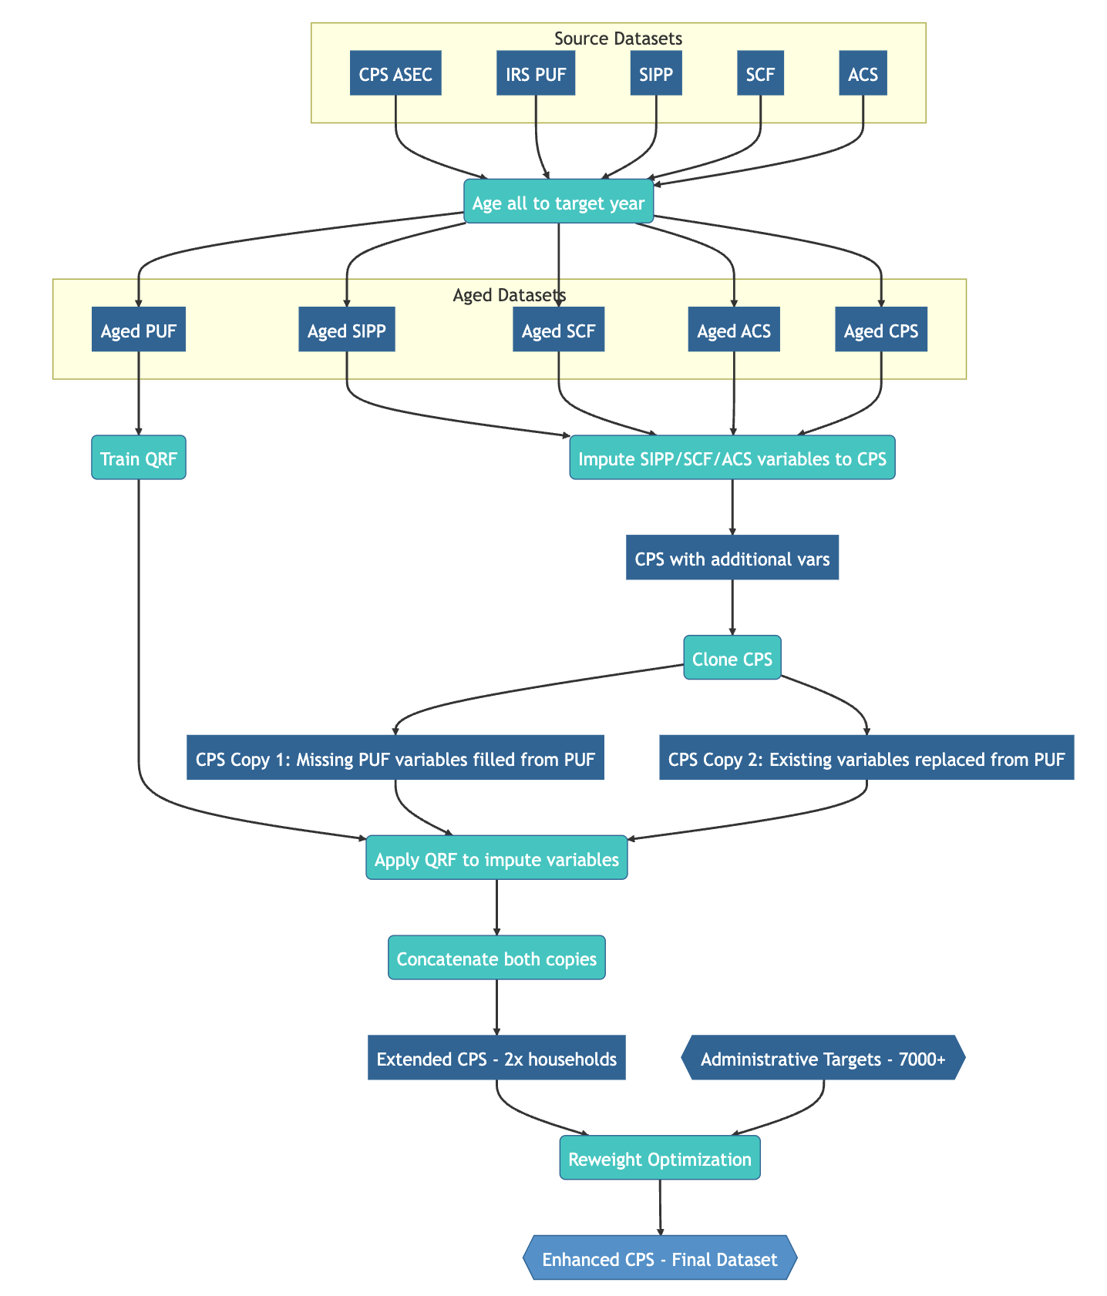
The PolicyEngine Data Pipeline Uses Both
OBBBA
improvements
State + district calibration
Notes:
Survey of Income and Program Participation (SIPP)

Slide 28
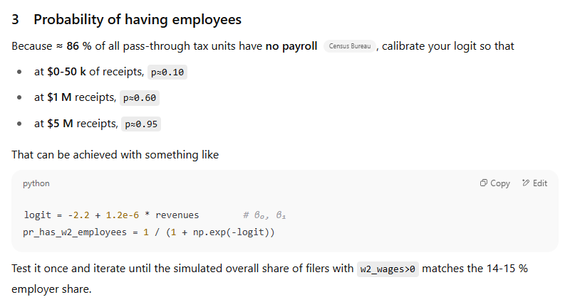
Beyond Data Fusion: Variable Simulation (in the Monte Carlo Sense)
The OBBBA reconciliation house bill introduced substantial logic changes in the Qualified Business Income Deduction phase-in of limitations
W2 wages and qualified property are important, but were being set naively (as a simple fraction, or set to zero).
OpenAI’s o3 was used to create an in-depth simulation of qualified business income and its components

Slide 29
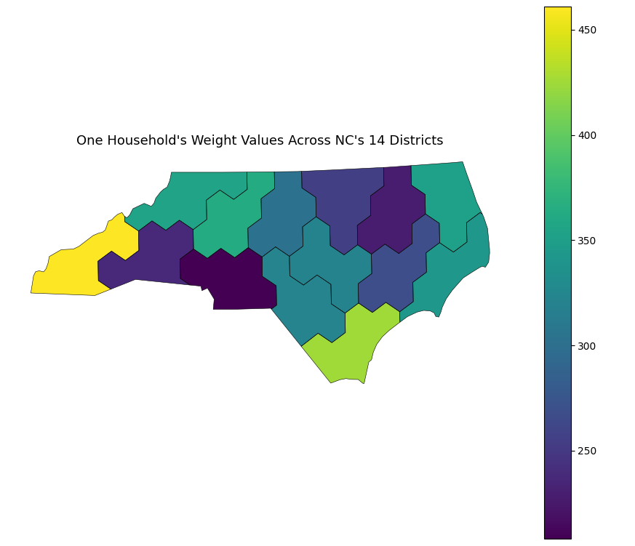
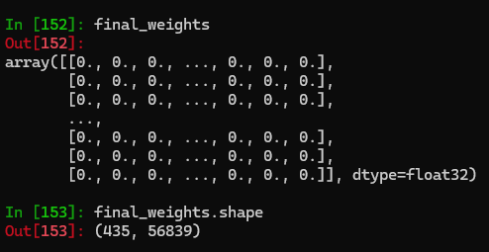
Introducing an Empirical Superpopulation For Local Area Estimation
For small-area estimation like congressional districts, we borrow from the larger population
The superpopulation households get a different weight per district
Most weights are zero!
Married No children $0 AGI (only $32k SS benefits)

Slide 30
Demo 3
Lifting California’s SNAP net income limit

Slide 31
Modeling is Critical for Cliffs and MTRs
Cliffs are a special case of a general issue of marginal tax rates
Assessing them at an individual level requires detailed policy rules
Reforms can have mixed, counterintuitive effects
Determining net effect requires microsimulation with high-quality data
We invite you to join PolicyEngine's user community to research this critical issue with our free, open-source platform

Slide 32
The PolicyEngine Codebase

Slide 33
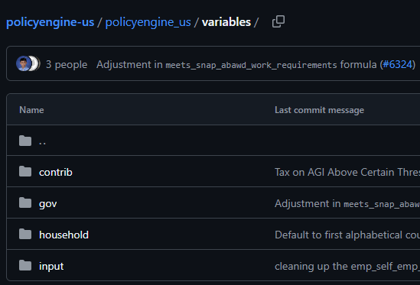
The policyengine-us Package Has The Rules
URL: github.com/PolicyEngine/policyengine-us
Root: github.com
Organization: /PolicyEngine - over 100 repos!
/policyengine-us - the “rules engine” repo for the US
Over 18,000 commits!
Interactive “Hunt”
Step into the folder policyengine_us
Click on either “parameters” or “variables”
How many SNAP related parameters and variables can you find?
From the commit message, SNAP modeling work is in progress!

Slide 34
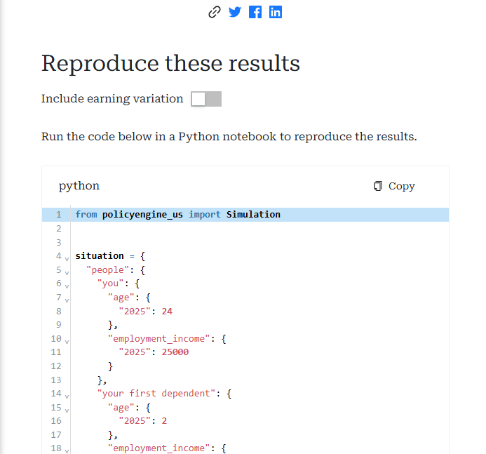
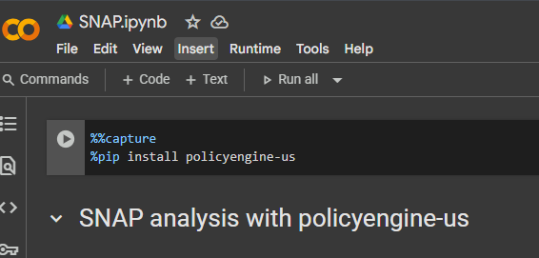
Run the Code with Google Colab
colab.google.com is a great way to get started, has Python ready to go!
Start by installing policyengine-us
The source code for policyengine-us is on Github: https://github.com/PolicyEngine/policyengine-us

Slide 35
The Future of Benefits Analysis with PolicyEngine

Slide 36
Continued Innovation on the Pillars
Rules
Dynamics
Data
TANF & CCDF nationwide
Section 8
State & local payroll taxes
Federal/state/local cost-sharing
Recertification schedules
Policy Library
Capital gains responses
Effects of poverty on outcomes like child welfare
General equilibrium modelling
State & congressional district breakdowns Coming by September!
Asset & consumption imputations
Monthly-izing
Notes:
Note a drawback of just using one dataset General equilibrium

Slide 37
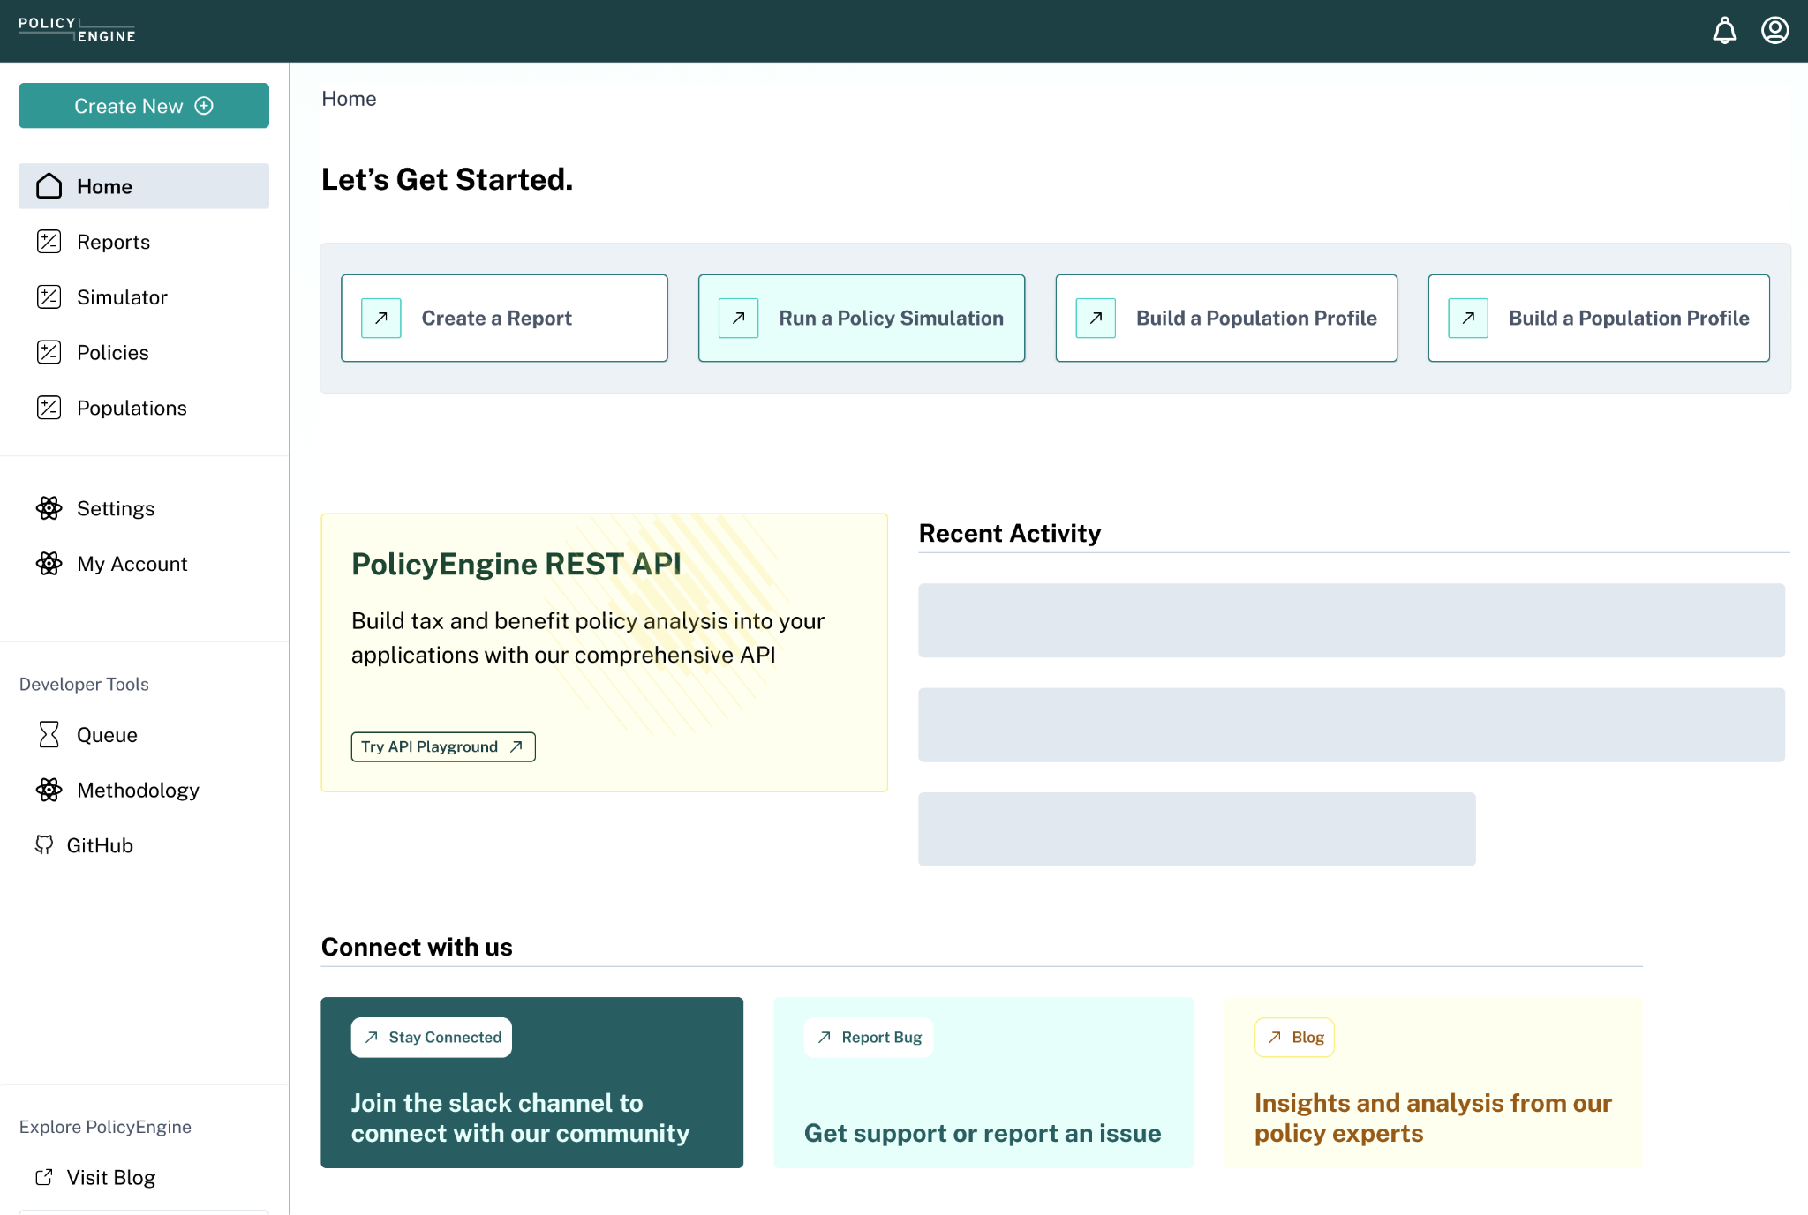
Towards a Comprehensive Policy Workbench
Notes:
Mention CFI and DPG
Kathy reached out

Slide 38
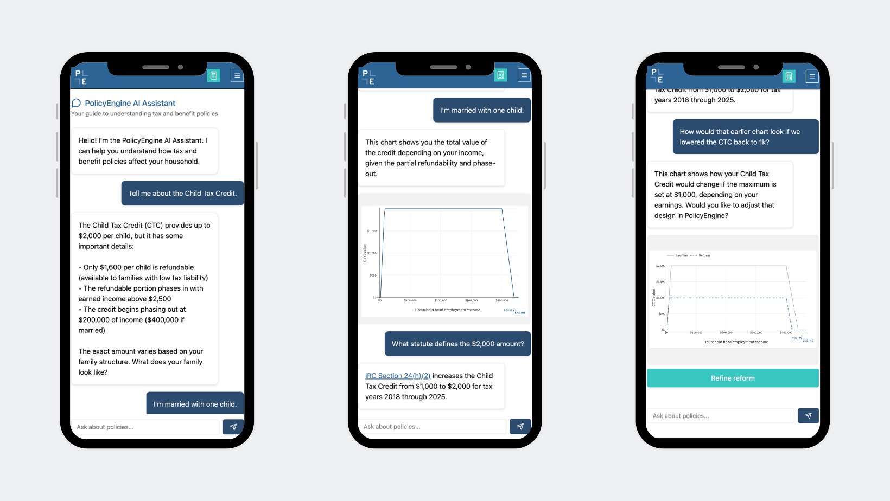
Enabled by an AI policy advisor
Notes:
Mention CFI and DPG
Kathy reached out

Slide 39
We’re Eager to Work With You!
Again — it’s all free and open source! Check it out!
We offer pro bono research support
Consulting/subgrants for larger projects
Feedback and feature requests welcome
We invite and train for open source contributions
Let’s advance evidence-based policymaking together!

Slide 40
Thank you!
ben.ogorek@policyengine.org

